Slide 1
Investigate a Relational Database in SQL
Project Presentation by Lohith Maira
Programming for Data Science with Python Nanodegree

Slide 2
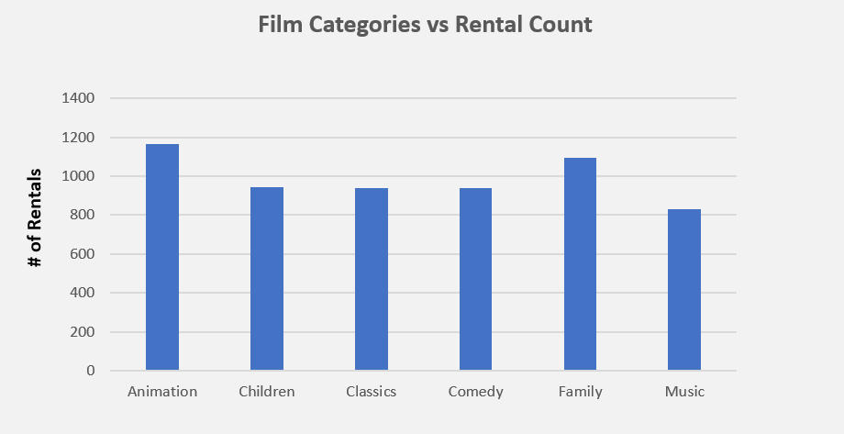
How many times a movie that belongs to a specific category is rented out ?
As seen from the chart ‘Animation’ movies are leading in numbers, aprrox. rented out for 1190 times followed by the genre ‘Family’ movies which are almost same.
Also there is an even distribution of other film categories & the least one that’s rented out belongs to ‘Music’ category.
*Note: this data is from May-2005 till Feb-2006

Slide 3
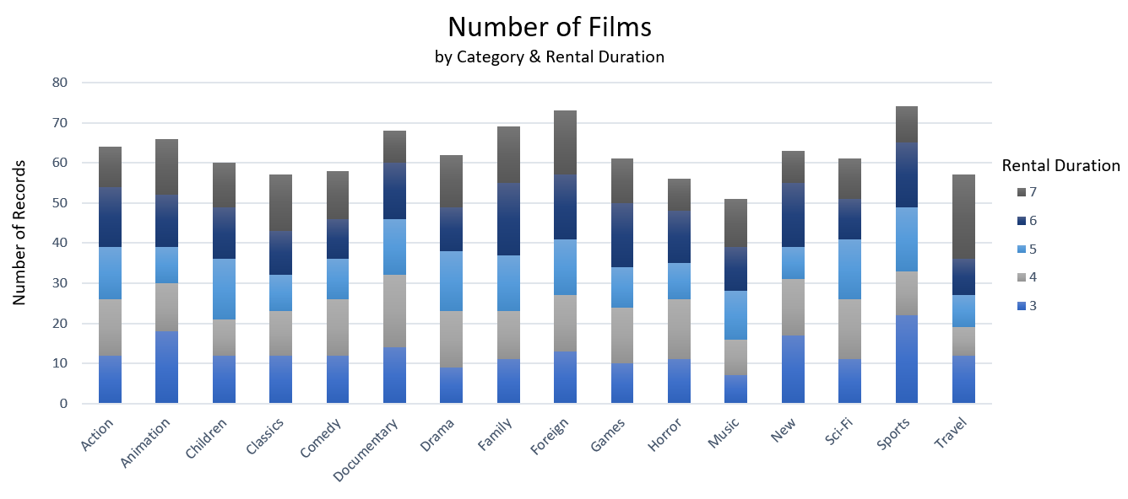
Pattern of length of rental duration of family-friendly movies in comparison with all other movies.
From stats its observed that out of 1000 movies 361 movies belongs to family category & the remaining 639 movies are non-family category.
Family Movies: 1824 is the Rental Duration
Non-Family Movies: 3161 is the Rental Duration
Movie Genres & Number of days rented out by most people:
Also from Non-family movies, movies from Sports & Foreign categories are rented out in highest numbers.
Animation : 3 | Children: 5
Classics: 7 | Comedy: 4
Family: 6 | Music: 5 or 7

Slide 4
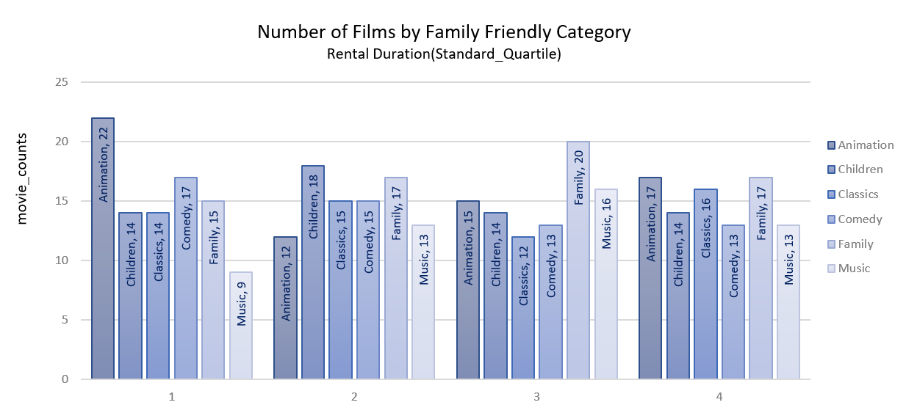
Which category of family friendly movies are rented the most for a standard quartile by rental duration?
Observations:
In 1st quartile, Animation films are rented the most;
In 2nd quartile, Children films are rented the most;
In 3rd quartile, Family films are rented the most;
In 4th quartile, both Animation & Family movies are rented the most.

Slide 5
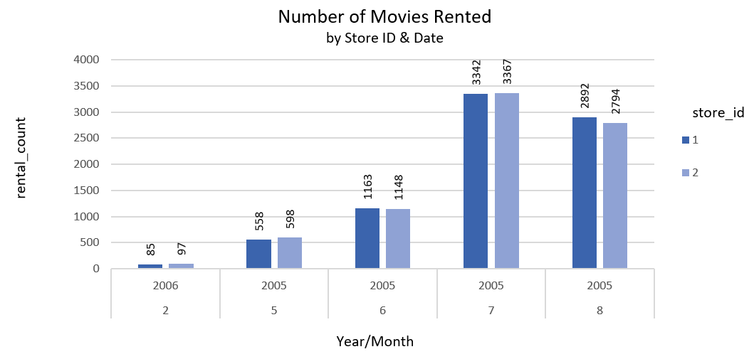
Show the number of movie rentals per store id & monthly data ?
Both the stores rents out almost same number of movies
In the year 2005, July month observed highest number of movie rentals & June month observed the least.

